Slide 1
Data Mesh 101
Notes:
Welcome to this course on Data Mesh. In it we’ll learn what a Data Mesh is, the challenges and trade-offs faced during the implementation, and the best approaches for building one in your organization.

Slide 2
What’s Covered
1 What Is Data Mesh?
2 Hands On: Creating Your Own Data Mesh
3 Data Ownership by Domain
4 Data as a Product
5 Data Available Everywhere, Self-Service
6 Data Governed Wherever It Is
7 Implementing a Data Mesh
8 Hands On: Exploring the Data Mesh
9 Hands On: Creating a Data Product

Slide 3
What Is Data Mesh?
Notes:
The “data mesh” is a set of principles for designing modern data architectures in a similar vein to the way Microservices are a set of principles for modern software architecture. The four principles that data mesh includes are all technology agnostic, but the best way to think about it is to frame the problem that it solves: A well implemented data mesh lets you scale a data architecture in terms of both the technology and the business organization.

Slide 4
What Is Data Mesh?
Data Marts
DDD
Microservices
Event Streaming
DATA MESH
Domain
Data Product
Inventory
Shipments
...
Orders
Notes:
The data mesh has many genetic influences, including Data Marts, Domain Driven Design, Microservices, and Event Streaming. We will get into more detail throughout this course. But, for now, we can say that these influences...

Slide 5
The Principles of a Data Mesh
1
2
3
4
Data ownership by domain
Data as a product
Data available everywhere, self serve
Data governed wherever it is
Notes:
...all culminate in four principles that govern how data is managed in the mesh:
1) Data is owned by a specific domain, in much the same way microserves each own a specific business function. Access to this data in decentralized.
2) Data is considered a product by each team that publishes it: something they are wholly responsible, thinking of it as a “product”
3) Data is available to anyone, anywhere in the company, all self service. So say you’re producing a report sales forecast for Japan, you can find and source of the data you need to drive that report in a few minutes, getting the data into a database you have control of.
4) Data is governed wherever it is. No data architecture is perfect no data architecture is static. They always evolve and grow. Governance ring-fences this allowing you to trust and more quickly navigate the data in the mesh.

Slide 6
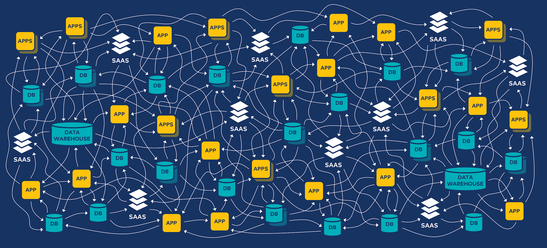
Spaghetti: Data Architectures Often Lack
Rigor
Notes:
Data architectures often lack rigor and evolve in an ad-hoc way. Applied well, this takes a messy architecture like this one...

Slide 7
Centralized Event Streams. Decentralized Data Products.
Apps
Apps
Kafka
Apps
Apps
Apps
Apps
Centralize an immutable stream of facts. Decentralize the freedom to act, adapt, and change.
Notes:
...and turns it into something much more uniform and manageable like this. A kind of central nervous system for the data in your organization. So, if something happens in one part of your organization, it can immediately trigger something to happen in another part.
This kind of approach solves many common problems. At a smaller scale, it addresses many of the issues we see with data pipelines, which often become brittle and problematic over time. It also addresses larger organisational issues; for example, different departments in a company disagreeing on core facts of the business.
In both cases, the Data Mesh principles, when applied right, can bring much needed order to the system. This results in a more mature, manageable data architecture.

Slide 8
A First Look
DATA MESH
Domain
Data Product
Inventory
Shipments
...
Orders
Notes:
The data mesh concept has both organizational and technical dimensions. But, essentially, we can think of a data mesh as a network to exchange data about the business, with nodes and connections. The nodes in the mesh are the “data products”—we’ll learn more about them later, but for now let’s just imagine a node could be a microservice, a database, an application, etc. The nodes function is to produce and consume high-quality, locally-curated data within the mesh for the benefits of other nodes. “Related” nodes, so to speak, are grouped into domains, like “Inventory”. And the data flows from node-to-node and thus from domain-to-domain as needed.So that’s a quick look at what a data mesh is. In the next module, we’ll dive into the first principle of a data mesh in more detail, as we explore data ownership by different domains.

Slide 9
GET STARTED TODAY
Confluent Cloud
cnfl.io/confluent-cloud
PROMO CODE: DATAMESH101
$101 of free usage
Notes:
The course will have exercises that will have you produce data to and consume data from Confluent Cloud. If you haven’t already signed up for Confluent Cloud, sign up now so when your first exercise asks you to log in, you are ready to do so. Be sure to use the promo code DATAMESH101 when signing up to get the $101 of free usage that it provides.
Walk through signup process:
Initial page (name, email, etc.)
Click Start Free button
Check for confirmation email and click the link to continue
Page for guided tutorial comes up, we’ll skip that for now
Create Cluster page comes up, we can see different cluster types
Choose Basic cluster and click Begin configuration button
Cloud Provider settings: Choose GCP, US-Central1, single AZ
Review / launch page: review charges and give cluster a name
Click Launch Cluster
Cluster completed page comes up
Expand menu and choose Billing & payment, then click on Payment details
See that you have $400 in free Confluent Cloud usage Expand Promo code field
Enter promo code DATAMESH101 for an additional $101 of free usage and click save
Back to Cluster completed page, click “I’m not ready yet, let me explore”
Explore our new cluster
The "promo code" must be activated before December 31st, 2024, directly within the Confluent Cloud billing interface. Once activated, the promo value will be available for consumption for 90 days, beginning on the date of activation. Promo value will automatically be applied to any usage charges incurred after activation. Any unused promo value on the expiration date will be forfeited. If you receive an invalid promo code error when trying to activate a code, this means that all promo codes have already been claimed.

Slide 10
Hands On: Creating Your Own
Data Mesh

Slide 11
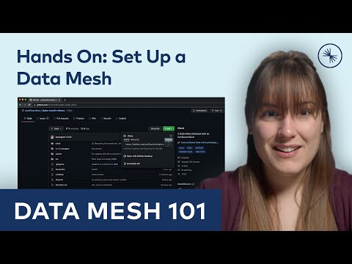
Hands On: Creating Your Own Data Mesh
Notes:
Set Up Confluent Cloud and Prepare to Build the Data Mesh
0:32 Open a browser to the data mesh prototype GitHub repository to obtain source code and documentation.
0:42 To run the demo, some developer tools are to be installed before proceeding: ome developer tool prerequisites you'll need installed on your system: git is required to clone the project, the make tool is needed to run the data mesh creation script and build the application, the jq JSON processing tool is used by the data mesh creation script, and Docker to run the local web server.
1:29 To run the script that provisions these resources, you’ll need the Confluent Command Line Interface installed on the system ‘PATH’. CLI can be installed using the provided installer script.
1:41 Create Confluent Cloud account to proceed: Sign up, apply promo code DATAMESH101, and provide a payment method to keep on file.
Run the Data Mesh
2:56 After cloning the source code repository, navigate into the directory where the project was cloned.
3:20 Use the ‘save’ option after logging in.
3:33 The project uses a ‘make-file” to bootstrap the entire data mesh environment, including Confluent Cloud resources, a Java Spring Boot Web server container, and a browser based client application that can be used to interact with the mesh.
3:48 Kick off the mesh creation by running ‘make data mesh’

Slide 12
Data Ownership by Domain

Slide 13
The Principles of a Data Mesh
1
2
3
4
Domain-driven Decentralization
Data as a First Class Product
Self-Serve Data Platform
Federated Governance
Local Autonomy (Organizational Concerns)
Notes:
Let's look at the first principle, domain-driven decentralization. The objective of this particular principle is to ensure that data is owned by those that truly understand it. This pattern is a reaction to what we have come to realize over the years in practice: that a centralized approach simply does not work at non-trivial scale—it might work for a small startup, but not for an enterprise. And probably the best way to understand this pattern on decentralization is to think about not the pattern, but its anti-pattern. Think about the central data warehouse of a company.

Slide 14
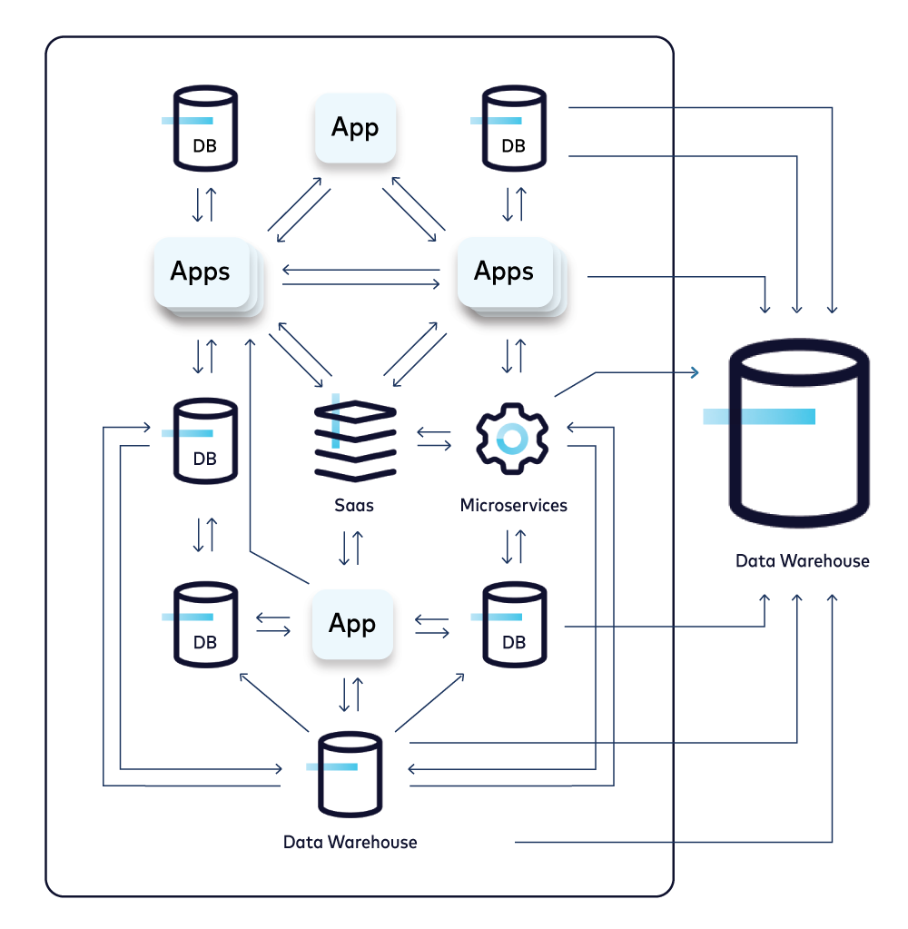
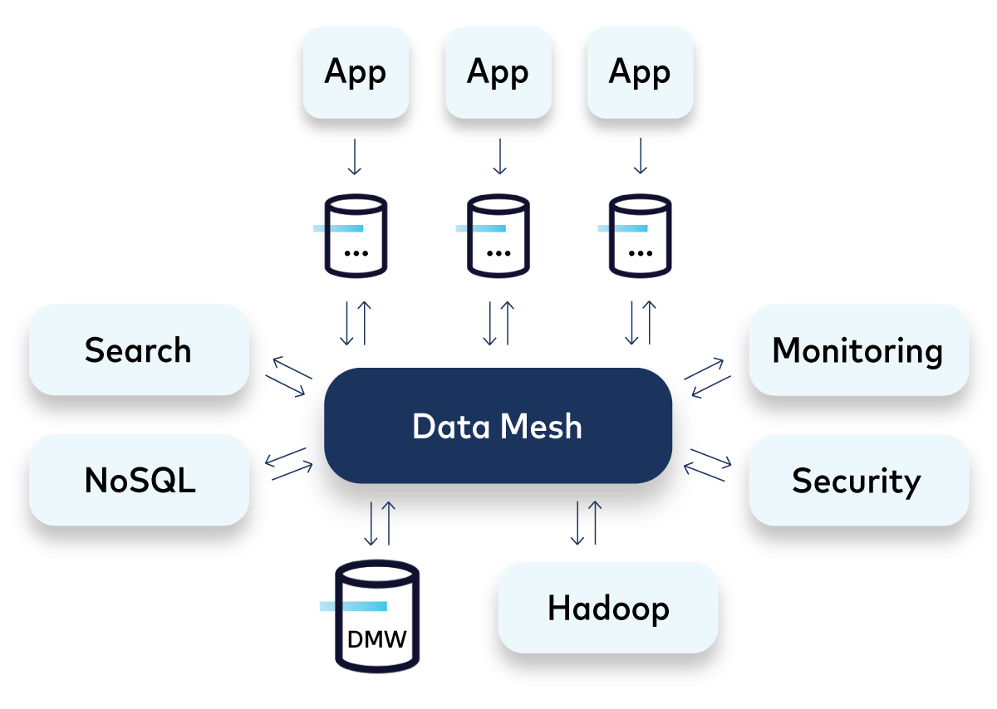
Principle 1: Domain-Driven Decentralization
Objective: Ensure data is owned by those that truly understand it
Anti-pattern: responsibility for data becomes the domain of the DWH team
Pattern: Ownership of a data asset given to the “local” team that is most familiar with it
Centralized
Data Ownership
Decentralized
Data Ownership
Notes:
The typical implementation of a DWH is that we have many data sources spread across the company, with vastly different levels of quality. There will be many ETL jobs which are pulling these data sets back to the central data warehouse. And the DWH teams are often required to clean up and fix a lot of that data, even though they are not really understanding the data sets that well, certainly less well than the domain teams from where this data originates. Another challenge is that these source systems, which are feeding data to the data warehouse, don't behave particularly well as they haven’t been built with responsible data sharing in mind: that is, they don’t have the responsibility in the organization to vend good quality data so it can be efficiently used by other teams.

Slide 15
Practical Example
Order Data
Shipping Data
Joe in Inventory has a problem with Order data.
Inventory items are going negative, because of bad Order data.
He could fix the data up locally in the Inventory domain, and get on with his job.
Or, better, he contacts Alice in Orders and get it fixed at the source. This is more reliable as Joe doesn’t fully understand the Orders process.
Ergo, Alice needs be an responsible & responsive “Data Product Owner”, so everyone benefits from the fix to Joe’s problem.
Orders Domain
Shipment Domain
Alice
Inventory
Billing
Recommendations
Joe
Notes:
Let's take a practical example. Imagine Alice is working on the order service at the top. We have Joe down in the Inventory management at the bottom. And Joe gets some bad order data from Alice. What does he do? Well, his first option is to try and fix that data locally, for himself. He may be able to do that, he may not, but let's say he does. The problem is that doing so just fixes the data for him. Also, he is coupling his Inventory product to the local fixes that he's applied, which has the risk of breaking down if Alice decides to fix the problem at the source, i.e., in the Orders service.
So a much better approach is for Alice to fix Joe’s problem at source for the benefit of Joe but also other teams. This way, everybody in the organization can benefit from this change. But for that to work there must be (1) a process where Joe and Alice can communicate quickly and (2) Alice must be a responsible member of the data mesh, who is both willing and able to make such changes quickly so that her data in the mesh is always of good quality. In summary, we can say that this approach ensures that data does not diverge in different ways across the organization.

Slide 16
Recommendations: Domain-Driven Decentralization
Learn from DDD:
Use a standard language and nomenclature for data.
Business users should understand a data flow diagram.
The stream of events should create a shared narrative that is business-user comprehensible.
Notes:
The main recommendation we can take from this first principle on domain-driven decentralization, is to learn from Domain-Driven Design (DDD). You should use a standard language and nomenclature for data. And there is a good litmus test for this: If your business users cannot understand the data flow diagrams, then you're probably not publishing data in the right way. It's probably too technical, which is the common issue that usually occurs. Instead, the stream of events should create a shared narrative that business users can actually understand, and their various flows through the mesh are comprehensible by the users.
This wraps up the first principle of a data mesh, which covered domain-driven centralization.. In the next module, we’ll dive into the second principle of a data mesh, as we explore treating data as a first-class product.

Slide 17
Data as a Product

Slide 18
The Principles of a Data Mesh
1
2
3
4
Domain-driven Decentralization
Data as a First-Class Product
Self-Serve Data Platform
Federated Governance
Local Autonomy (Organizational Concerns)
Product thinking, “Microservice for Data”
Notes:
Let’s talk about the second principle: treating data as a first-class product. This is arguably the most important principle of the four.

Slide 19
Principle 2: Data as a First-Class Product
Objective: Make shared data discoverable, addressable, trustworthy, secure, so other teams can make good use of it.
Data is treated as a true product, not a by-product.
This product thinking is important to prevent data chauvinism.
Notes:
This principle is about product thinking: Your domain’s shared data is managed as a true product. And your objective is to provide this data product in the right way, so that other teams can make good use of it. In other words, you treat the other teams as internal customers of your data. This product thinking is really important to prevent data chauvinism, which is a risk of principle 1 that we covered in the previous module. That’s because decentralization and granting local autonomy to domains may cause the creation of even more data silos, along with serious data quality problems if the origin domains only care about themselves. So, what is “a data product” then? Let’s find out.

Slide 20
Data Product, a “Microservice for the
Data World”
Data product is a node on the data mesh, situated within a domain.
Produces—and possibly consumes—high-quality data within the mesh.
Encapsulates all the elements required for its function, namely data + code + infrastructure.
“Items About to Expire”
Data Product
Data and metadata, including history
Creates, manipulates, serves, etc. that data
Data
Code
Domain
Data Product
Infra
Powers the data (e.g., storage) and the code (e.g., run, deploy, monitor)
Notes:
Think of a data product as a microservice for the data world. It is a node on the data mesh, situated within a particular domain. The role of the data product is to produce—and possibly consume—high-quality data within the mesh. And, like a microservice, it encapsulates everything it needs for its functioning: (1) the actual data that we want to share with the outside world, (2) the code that creates, manipulates, and shares that data, (3) the infrastructure that we need to store the data and to run the code. So, as you can see, it’s really similar to microservices.
Now, before we take a closer look at a data product, let’s first zoom out again to the bigger picture of the data mesh.

Slide 21
Connectivity Within the Mesh Lends Itself …
DATA MESH
Domain
Data Product
Notes:
Because a key question is: How is data shared across data products in the mesh? That is, how do we implement the links and connections between the nodes in the network? And, even visually, we can see that this interconnectivity lends itself very naturally to … [NEXT SLIDE]

Slide 22
…Naturally to Event Streaming with
Apache Kafka®
DATA MESH
Domain
Data Product
Mesh is a logical view, not physical!
Notes:
...Event Streaming with Kafka. Here, data is provided to other data products through streams in Kafka. And any data product can consume via Kafka from the high-quality data streams of other data products. As we can see, this idea of a data mesh is very similar to the idea of a Central Nervous System, where data is continuously flowing, being processed, analyzed, acted upon. Now, we must remember that the data mesh shown here is a LOGICAL view, not a physical one. If you know Kafka, you know that the reality looks a bit different and...better.

Slide 23
Event Streaming Is the Pub/Sub, Not
Point to Point
Data producers are scalably decoupled from consumers
Data
Product
Data
Product
Data
Product
Data
Product
write
(publish)
read
(consume)
independently
stream
(persisted)
other streams
Notes:
Event streaming is not a point-to-point architecture that leads to this spaghetti mess we have seen in module 1 at the beginning of this course. Instead, it is an architecture that decouples data producers from data consumers in a way that is highly scalable, fault-tolerant, and persistent (because streams are durably stored). Here, a data product talks to other data products only INDIRECTLY, and this layer of indirection is event streams in Kafka. So this setup is Write-Once, Read-Many. And all a data product has to do to participate in a data mesh is to publish its “public” data as streams, and then other data products can independently consume this data in the way they see fit.
Now, as a quick refresher, let’s recap the key properties of event streams and why they are such a great fit to build a data mesh.

Slide 24
Why Is Event Streaming a Good Fit for Meshing?
Data
Product
Data
Product
1 | 2 | 3 | 4 | 5 | 6 | 7
Streams are real-time, low latency ⇒ Propagate data immediately.
Streams are highly scalable ⇒ Handle today’s massive data volumes.
Streams are stored, replayable ⇒ Capture real-time & historical data.
Streams are immutable ⇒ Auditable source of record.
Streams are addressable, discoverable, … ⇒ Meet key criteria for mesh data.
Streams are popular for Microservices ⇒ Adapting to Data Mesh is often easy.
Notes:
Here are some of the reasons. For example, streams are real-time, so you can propagate data throughout the mesh immediately, as soon as new information is available. Streams are also persisted and replayable, so they let you capture both real-time AND historical data with one setup. And because they are immutable, they make for a great source of record, which is useful for governance purposes. Kind of a thing already for Microservices!

Slide 25
How to Get Data Into and Out of a
Data Product
Continuous
Stream
Continuous
Stream
1
Data
Product
2
Snapshot via
Req/Res API
Input Data Ports
Output Data Ports
Snapshot via
Req/Res API
3
Snapshot via Nighty ETL
Snapshot via Nighty ETL
Notes:
So, let’s get back to data products and the question of how do we get data into and out of a data product? There are three main options.
A) Use streams. We already discussed why this is a good fit in a data mesh. A strong advantage is that they continuously import and export data as soon as new information is available in the business.
B) Use Request-Response APIs to request a data snapshot on demand, like a file export.
C) Use traditional ETL for batch import/export of nightly snapshots. This gives you a fixed cadence of importing and exporting these snapshots, but, compared to option B, less control over exactly what snapshot data you’ll be working with.

Slide 26
Onboarding Existing Data
Use Kafka connectors to stream data from cloud services and existing systems into the mesh
Data
Product
Source Connectors
Input Data Ports
https://www.confluent.io/hub/
Notes:
With event streaming, you can quickly onboard data from existing systems through Kafka connectors that stream data from these systems into the mesh in real-time. There are two hundred of such connectors readily available, so in most cases you don’t have to write anything yourself. So this is a great way to set data in motion when you are bootstrapping a data mesh.

Slide 27
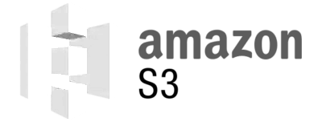
Data Product: What’s Happening Inside
Input Data Ports
Output Data Ports
…pick your favorites...
Data on the Inside: HOW the domain team solves specific problems internally? This doesn’t matter to other domains.
Notes:
Now that there is some data flowing into our data product, what’s happening then? Well, really, what’s happening inside a data product is of no concern to the data mesh. Apart from the team responsible for a data product, everybody else in the data mesh only cares about the PUBLIC data that is shared by this domain. HOW this public data is created internally doesn’t matter, as long as it meets criteria such as being addressable, trustworthy, have good quality, and so on.

Slide 28
Event Streaming Inside a Data Product
Use ksqlDB, Kafka Streams apps, etc., for processing data in motion
1
Stream data from other DPs or internal systems into ksqlDB
2
ksqlDB to filter, process, join, aggregate, analyze
3
Stream data to internal systems or the outside. Pull queries can drive a req/res API.
Input Data Ports
Output Data Ports
Pull Queries
Req/Res API
Notes:
That being said, the local team does care about how the data is being made, of course. And, among other interesting technologies, event streaming is also very useful to implement the insides of a data product. Naturally, you’d use streaming tools like the streaming database ksqlDB and the Kafka Streams client library to process any streaming data that enters or is created within a data product, and streaming data that leaves and thus is shared with the outside world in the data mesh. If you are interested to learn more, we have separate courses available for you that cover ksqlDB and Kafka Streams in detail.

Slide 29
Event Streaming Inside a Data Product
Use Kafka connectors and CDC to “streamify” classic databases
1
Stream data from other Data Products into your local DB
2
DB client apps work as usual
3
Stream data to the outside with CDC and e.g. the Outbox Pattern, ksqlDB, etc.
Input Data Ports
Output Data Ports
Sink Connector
Source Connector
MySQL
Notes:
Likewise, if you use non-streaming systems within a data product, like relational databases and cloud storage services, you can “streamify” them via Kafka connectors. For example, as shown here, you can feed real-time updates into relational database like MySQL from upstream data products to keep the database current with the latest business information, and any existing applications that interact with the database can continue to work as usual. And similarly, any changes to the database itself—like updates to a customer profile—can be captured and shared as event streams with the outside world in the data mesh.

Slide 30
Dealing with Data Change: Schemas and Versioning
Publish evolving streams with back/forward-compatible schemas.
Publish versioned streams for breaking changes.
Data
Product
V2 - userAnonymized, product, quantity
Output Data Ports
V1 - user, product, quantity
Also, when needed, data can be fully reprocessed by replaying history.
Notes:
This brings us to the last point: In which way should we share our data product’s streams within the mesh? The two main considerations here are the use of schemas and the use of versioning. When you publish a stream, you should use schemas with appropriate backwards and/or forwards compatibility. This ensures, for example, that when you add a new data field to a stream, that any existing consumers of that stream can continue to operate without having to make any changes. However, if you do need to introduce breaking changes to the schema of a stream, then use versioned streams. For example, if you are being required to obfuscate certain data fields moving forward, which likely DOES break existing consumers, then publish a new version of your stream, and deprecate the original version.

Slide 31
Recommendations: Data as a First-Class
Product
Data-on-the-Outside is harder to change, but it has more value in a holistic sense.
Use schemas as a contract.
Handle incompatible schema changes using Dual Schema Upgrade Window pattern.
Get data from the source, not from intermediaries. Think: Demeter's law applied to data.
Otherwise, proliferation of ‘slightly corrupt’ data within the mesh. “Game of Telephone”.
Event Streaming makes it easy to subscribe to data from authoritative sources.
Change data at the source, including error fixes. Don’t “fix data up” locally.
Some data sources will be difficult to turn into first-class data products. Example: Batch-based sources that lose event-level data or are not reproducible.
Use Event Streaming plus CDC, Outbox Pattern, etc. to integrate these into the mesh.
Notes:
The main recommendations we can take from this second principle on Data As a First-Class Product start with the realization that data-on-the-outside is harder to change, but it has more value for the organization at large. Because of this, you should use schemas to put data contracts in place. There will be situations in practice where a data product is forced to make incompatible changes to its schemas, which you can address with the Dual Schema Upgrade Window pattern (see http://www.benstopford.com/dual-schema-upgrade-window-pattern-kafka/).
The next recommendation is that, in a data mesh, you should always favor getting the data from the source, rather than from intermediaries. Otherwise, the data quality will deteriorate more and more the more “hops” it is away from the source, like in a game of telephone. Thankfully, it is easy to circumvent this problem through event streaming. With event streaming, you can easily subscribe to data directly from the respective authoritative sources.
The third recommendation is to change data at the source whenever there is a need for such changes, such as in the case of fixing errors. You should not fix data up locally for the reasons we mentioned earlier in this module at the example of Alice in Orders and Joe in Inventory.
Lastly, you will soon realize that some data sources will be difficult to onboard into a data mesh as first-class data products. This can be for a variety of reasons, some of which can be organizational, some of which can be technical. For example, batch-based sources often lose event-level data, or they are not reproducible. In such a situation, use event streaming together with Change Data Capture (CDC), the Outbox pattern, etc. to integrate these problematic sources into the mesh.
The main recommendation we can take from this first principle on domain-driven decentralization, is to learn from Domain-Driven Design (DDD). You should use a standard language and nomenclature for data. And there is a good litmus test for this: If your business users cannot understand the data flow diagrams, then you're probably not publishing data in the right way. It's probably too technical, which is the common issue that usually occurs. Instead, the stream of events should create a shared narrative that business users can actually understand, and their various flows through the mesh are comprehensible by the users.
This wraps up the second principle of a data mesh, which covered treating data as a first-class product. In the next module, we’ll dive into the third principle of a data mesh, as we explore making data available everywhere in a self-service manner.

Slide 32
Learn More
Find out how to implement a Data Product for data in motion with:
Apache Kafka 101 course
Kafka Connect 101 course
Building Data Pipelines with Apache Kafka & Confluent course
ksqlDB 101 course
developer.confluent.io/learn-kafka/

Slide 33
Data Available Everywhere, Self-Service

Slide 34
The Principles of a Data Mesh
1
2
3
4
Domain-driven Decentralization
Data as a First Class Product
Self-Serve Data Platform
Federated Governance
Local Autonomy (Organizational Concerns)
Product thinking, “Microservice for Data”
Infra Tooling, Across Domains
Notes:
Let’s talk about the third principle: building a self-serve data platform.

Slide 35
Why Self-Service Matters
Trade Surveillance System
Data from 13 sources
Some sources publish events
Needed both historical and real-time data
Historical data from database extracts arranged with dev team.
Format of events different to format of extracts
9 months of effort to get 13 sources into the new system.
Notes:
Principle 3 is about a problem many of you will have faced in your day to day work. How to you access data in a reasonable amount of time? Let’s take an example I’ve seen in the past. There was a new trade surveillance system being built in a large financial institution and it needed data from 13 different systems. The company had a messaging system in place so it could publish events from sources and lots of them did so, publishing events for others to receive.
However, while you could get hold of the realtime event stream, there wasn’t a simple way to also get historical data, and if you’re starting out from scratch you typically need the historical data in full: the initial load of data to put into your database which can then be kept up to date with the stream of events.
Some of those systems had a feature where you could submit a request for a backpopulartion and have historical events republished for you, but most systems didn’t have this feature automated. Instead you would be sent an data snapshot directly from their database.
They you hit another problem: The event streams and the snapshot file have completely different schemas, and different names for each field. This made it much more complex to get the realtime and historical data to match up, both in schema and in time.
So as a result, just getting the data into the database in a form that made sense, took about nine months. This is not an uncommon story, you'll find this in many products, many projects across different industries. Coming back to principle three: it’s about tackling exactly this problem: getting data into your product near instantaneously and providing a tight team feedback loop so they can iterate quickly on any issues that may come up.

Slide 36
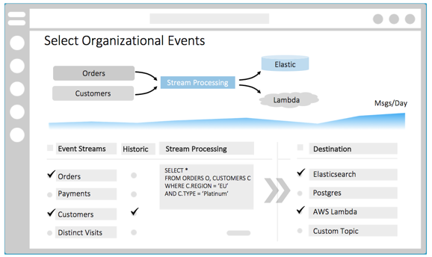
Principle 3: Self-Serve Data Platform
Central infrastructure that provides real-time and historical data on demand
Objective: Make domains autonomous in their execution through rapid data provisioning
Notes:
Unlike the other principles this is achieved through central infrastructure: centralized event streams and a centralized service for allowing you to discover and provision the data they contain.
Importantly the system needs to manage both reatime and historical data and make that data available anywhere, in any database in the company. The process of accessing data and geting it into our database should be autonomous. Just like microserivces, the most efficient architectures let us get the data that we want and execute it at our own cadence through this type of rapid data provisioning.

Slide 37
Consuming Real-Time & Historical Data from
the Mesh
Separate Systems for Real-Time and Historical Data (Lambda Architecture)
Considerations:
Difficulty to correlate real-time with historical “snapshot” data
Two systems to manage
Unlike event streams, snapshots have less granularity
One System for Real-Time and Historical Data (Kappa Architecture)
Considerations:
Operational complexity (addressed in Confluent Cloud)
Downsides of immutability of regular streams: e.g. altering or deleting events
Storage cost (addressed in Confluent Cloud, in Apache Kafka with KIP-405)
Notes:
Consuming from a data from the mesh means consuming both real-time and historical data. There's two ways of doing this. The first is the one that I described in the trade surveillance example where get hold of a data snapshot, and get hold of the event streams independently. You then put the snapshot and the event streams together in your database.
This is similar to the way that the Lambda architecture works if you're familiar with that pattern. There also, you have two systems, one for streams and one for batch, meaning two sources of the same data.
The solution to this is known as the Kappa Architecture. The event streaming platform stores the streams as events indefinitely. Destination data ports can then choose to start with the latest events, or to consume all historical events first. In Kafka we read historical events by first setting the topic to have infinite retention and then resetting our consumer back to offset zero so that all data in the topic is consumed, right from the start.
Compactly topics can also be used as an optimization to reduce the amount of time it takes to load that initial snapshot. Likewise, if you use something like Confluent Cloud, which has a more efficient mechanism for infinite storage, you can store these very large data sets indefinitely in a price-efficient manner.

Slide 38
What This Can Look Like in Practice
Browse Schemas
Notes:
So what does this look like in practice?
Well, there is no real implementation of this, there's no one tool that wraps the concept of a data mesh up in a single package. This is to be expected. Like microservices, the whole point of a data mesh is to be decentralized, so there absolutely shouldn’t be one tool. But there does need to be some single point you go to to discover the information in the mesh. This can be a UI, an API, or potentially something else, but it needs to exist, just like microservices typically have service discovery systems to help you figure out where endpoints are located.
Assuming it’s a user interface, data mesh UI’s look a little like this. You can type search terms and discover schemas. You can introspect the data flowing through the mesh. You can look at the various different datatypes and values there. You can request that events streams be joined and translated. In this example we have orders and customers selected.
One of them is a historical data set. The other one is solely real-time events.
A stream processing query, in this case it's using KSQL, then joins these together along with a pre-processing step that filters out the events we’re interested in –orders for platinum clients–and deposit that in elastic search for us to query.

Slide 39
Implementation: Database Inside Out
Messaging that Remembers
Connector
Database
STREAM
PROCESSOR
Connector
Database/View
Database
ksqlDB
Notes:
This is kind of an implementation of another pattern called “the database inside out”. Kafka provides the storage layer. ksqlDB provides query processing: transformation, joins, and the ability to create passive views which we can then send other queries to.

Slide 40
Data Mesh Is Queryable and Decentralized with ksqlDB
Events are the
interface to the mesh
Destination Data Port
STREAM
PROCESSOR
Query is the interface to the mesh
Notes:
Both of these provide an implementation which can manipulate the events which are held inside the central event streaming platform, the central data mesh, and materialize them either as events or a view that we can query.
This point is important as the mesh grows. Imagine that the data mesh becomes global, with many different nodes that span different continents.
Here we have a destination data port on the left, which has two types of interface that make the data in the mesh accessible.
The first interface uses events, that's the one at the top. The data port decines what data it is interested in, submits this to the mesh, and the mesh pushes events into the data port as they become available. Those events can then be persisted by the data port in whatever way suits them best, say into a database, S3, or whatever it might be.
The second implementation is query-based rather than event-based. Here we tell the data mesh to materialize a view for us. For example, we might materialize a view of orders that are for this particular customer.
We now interact with the mesh using a request response paradigm. We send the mesh a question and we are returned a result.

Slide 41
Mesh is One Logical Cluster. Data Product Has Another.
Data Product
has its own cluster
for internal use
Data
Product
Notes:
Finally, when a global data mesh is implemented with Apache Kafka the Mesh is really one logical cluster made from many physical ones spread around the globe. While the data product can use the mesh to send data to, or to receive data from if its playing the role of a destination data port, it typically cannot use the underlying Kafka implementation as that sits under central control. Instead it should use it’s own Kafka instance. This pattern is very simple to implement on the cloud using systems like Confluent Cloud, where more standard clusters introduce near-zero marginal cost.

Slide 42
Learn More
Find out more about how to use Kafka and event streaming:
Apache Kafka 101 course
Event Sourcing and Event Storage with Apache Kafka course
Learn how to create materialized views and process event streams:
Inside ksqlDB course
developer.confluent.io/learn-kafka/
Notes:
This wraps up the third principle of a data mesh, which covered making data available everywhere in a self-service manner. In the next module, we’ll dive into the fourth principle of a data mesh, as we explore federated governance.

Slide 43
Data Governed Wherever It Is

Slide 44
The Principles of a Data Mesh
1
2
3
4
Domain-driven Decentralization
Data as a First Class Product
Self-Serve Data Platform
Federated Governance
Local Autonomy (Organizational Concerns)
Product thinking, “Microservice for Data”
Infra Tooling, Across Domains
Interoperability, Network Effects (Organizational Concerns)
Notes:
Let’s talk about the fourth and last principle of a data mesh: federated governance for your data.

Slide 45
Principle 4: Federated Governance
Objective: Independent data products can interoperate and create network effects.
Establish global standards, like governance, that apply to all data products in the mesh.
Ideally, these global standards and rules are applied automatically by the platform.
Must balance between Decentralization vs. Centralization. No silver bullet!
What is decided locally by a domain?
Domain
Domain
Domain
Domain
What is globally? (implemented and enforced by platform)
Self-Serve Data Platform
Notes:
Like principle 1 (Decentralization), this principle is largely an organizational concern. The objective here is to ensure that all these independent, autonomous teams and data products within the mesh can work actually together—that is, we want to ensure that the various constituents in the mesh actually mesh so that we generate network effects for all this data we share across the organization. Predominantly, this task is about establishing global standards like data governance, and applying these across the full mesh. So, even though we started with decentralization in principles 1 and 2, we now want to strike the right balance between decentralization and centralization to tie everything together. This isn’t easy, and in practice the execution will likely differ from company to company. Let’s take a look at concrete examples.

Slide 46
Example Standard: Identifying Customers
Globally
Define how data is represented, so you can join and correlate data across different domains.
Use data contracts, schemas, registries, etc. to implement and enforce such standards.
Use Event Streaming to retrofit historical data to new requirements, standards.
Domain
Data Product
customerId=29639
customerId=29639
SELECT … FROM orders o
LEFT JOIN shipments s ON o.customerId = s.customerId
EMIT CHANGES;
customerId=29639
customerId=29639
Notes:
One important task is to ensure that “the same” data or data attribute is represented identically across different domains. Otherwise we can’t join or correlate, for example, data about our customers across the various domains like Inventory, Orders, and Shipments. We won’t have the time in this module to cover the how to define and agree upon such data models. But what we can say is that—once you have them—then data contracts, schemas, and schema registries will help you to implement and enforce such standards throughout the data mesh.

Slide 47
Example Standard: Detect Errors and Recover
with Stream
Use strategies like logging, data profiling, data lineage, etc. to detect errors in the mesh.
Streams are very helpful to detect errors and identify cause-effect relationships.
Streams let you recover and fix errors: e.g., replay & reprocess historical data.
My App
Data
Product
If needed, tell the origin data product to fix problematic data at the source.
Bug? Error? Rewind to start of stream, then reprocess.
Output Data Ports
Event Streams
give you a powerful
Time Machine.
0 | 1 | 2 | 3 | 4 | 5 | 6 | 7 | 8 | 9
Notes:
Another example is how data products should detect and recover from errors. Here, we can use common strategies like application logs, data profiling, and data lineage to unearth errors in the mesh. Streams are very useful here because they capture live AND historical data in a sequence of events, which let you identify cause-and-effect relationships much more easily—particularly if you can join and correlate streams from different domains as discussed in the slide before. Also, streams let you then recover and fix any such errors by replaying and reprocessing historical data.

Slide 48
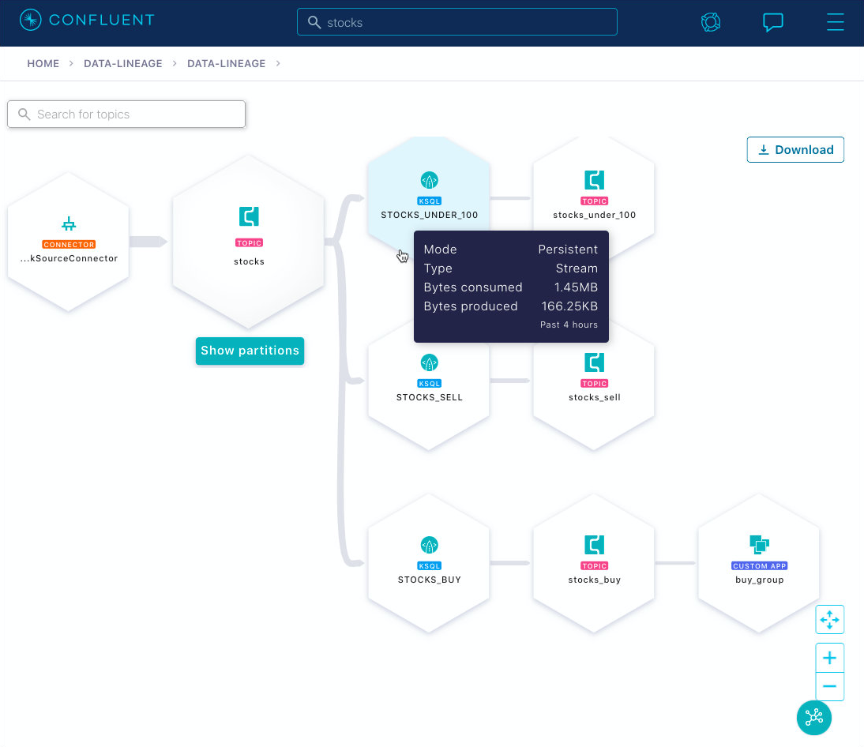
Example Standard: Tracking Data Lineage
with Streams
Lineage must work across domains and data products—and systems, clouds, data centers.
Event streaming is a foundational technology for this.
Domain
Data Product
Notes:
In this final example, we can see again that there are lots of data streams within a data mesh. These data streams may span across systems, data centers, clouds, and so on. For the purpose of tracking data lineage, we ideally want to cover the full mesh, so we must follow the data. Event streaming is again a key technology to implement this in practice, because it lets you track data-in-motion all the way from its origins to intermediate and to the final destinations.

Slide 49
Recommendations: Federated Governance
Be pragmatic: Don’t expect governance systems to be perfect.
They are a map that helps you navigate the data-landscape of your company.
But there will always be roads that have changed or have not been mapped.
Governance is more a process—i.e., an organizational concern—than a technology.
Beware of centralized data models, which can become slow to change. Where they must exist, use processes & tooling like GitHub to collaborate and change quickly. Good luck! 🙂
Notes:
Before we wrap up this module, let’s talk about some further considerations for federated governance. In my opinion, the most important recommendation is having the right mindset: be pragmatic! Don’t expect a governance system to be perfect. It only needs to be sufficiently good. There will always be parts of a data architecture that is not covered or that was just recently changed. So governance is really more an process than a technology. Lastly, we talked quite a bit about decentralization vs. centralization. Governance is on the centralized side. So while you probably want to standardize a number of things, please be aware of the downsides of centralized DATA MODELS, as they will eventually become too slow to change. If you really need something like this, use processes and tools like GitHub to collaborate efficiently, and have good luck! :-)
This wraps up the fourth principle of a data mesh, which covered federated governance. In the next module, we’ll dive into how to go about implementing a data mesh in practice.

Slide 50
Implementing a Data Mesh

Slide 51
Data Mesh Journey
Principle 3
Get access to any data immediately and painlessly, be it historical or real-time.
3
Start Here
Principle 2
Data is your product:
All exposed data should be good data.
Difficulty
to execute
Principle 1
Data should have one owner: the team that creates it.
2
1
Principle 4: Governance, with standards, security, lineage, etc. (cross-cutting concerns)
Notes:
In this final module, we take a look at the typical journey that you go through when implementing a data mesh in your organization. There are the four Principles of the data mesh, which we have covered in detail in the previous modules of this course. And we can really see these principles as an evolution. For instance, you don't really start with principle 3, and you're unlikely to skip principle 1. It’s really a chronological process you go through, with Principle 1, Principle 2, Principle 3. Principle 4 is maybe slightly different, but the generally the difficulty will be increasing as you go from #1 through to #3 in the journey.
We can note that Principles #1 and #2 are often used together. You should remember that Principle #1 is about the data should have an owner, and that owner should be the team that creates it. And Principle #2 is that the data is your product. All exposed data should be good data. This ensures that the data that you've entered into data mesh is of good quality.
Lastly, we want to emphasize that the data mesh is a concept, and you should really think of “building a data mesh in your company” as this journey. You didn’t have a data mesh last week, and you will not have a finished one next week. So, get the necessary management commitment, and then ideally start small with the first concrete use cases, and iterate from there. And finally, while the data mesh is certainly a valuable concept, it’s not the holy grail. The data mesh sits next to other useful concepts, like microservices and Domain Driven Design (DDD). And with its focus on analytical data, the data mesh is but one of the ways you can apply event streaming & Kafka to drive your business, just like you can use event streaming with microservices to implement the more operational systems. Apply these concepts in the way you see fit so that you can make technology useful in your company. To help you get started, let’s take a look at several concrete steps for implementing a data mesh in practice.

Slide 52
Implement a Data Mesh
Centralize data in motion
Introduce a central event streaming platform.
Nominate data owners
Firm owners for all key datasets in the organization. Make ownership information broadly accessible.
Data on demand.
Events are either stored in Kafka indefinitely or can be republished by data products on demand.
Handle Schema Change
Owners publish schema information to the mesh. Process introduced for schema change approval.
Secure event streams
Access to event streams is permissioned by a central body.
Connect from any database
Sink Connectors are made available for all supported database types to ease the provisioning of new output data ports in the mesh.
Central user interface
Discovery and registration of event streams
Searching schemas for data of interest
Previewing event streams
Requesting to access event streams.
Data lineage views

Slide 53
Hands On: Exploring the Data Mesh

Slide 54
Hands On: Exploring the Data Mesh
Notes:
0:20 If data mesh is successfully created you should see log entries
0:32 Open a browser to the landing page displaying an overview of the features of the data mesh prototype
0:46 Start with exploring the data products in the explore data products tab
0:51 Then, move on to creating and publishing data products
0:54 Select the Explorer tab where it shows data products available to you
1:12 Attributes included in such data products:
1:15 The "Domain" and "Owner" metadata values, representing governance responsibility over the data product
1:24 The "Quality" and "SLA" metadata values, which inform you of the data quality and service-level support you can expect when using the data product
1:32 A copy of the current schema, which helps you explore the data model fields and types that make up the data product
1:38 Below the "Data Products Detail" information are buttons that forward you to various views in the Confluent Cloud Console. Each of these views provide more detail about the data product:
1:52 The "Topic Detail" view in the cloud console provides information about the topic backing the data product, including production and consumption rates
2:00 "Data Lineage" provides detailed information about the data product’s relationships with other upstream and downstream applications and dependencies
2:08 "Export" links you to Kafka Connect, where you can set up an export connector to move data into your application's data store

Slide 55
Hands On: Creating a Data Product

Slide 56
Hands On: Creating a Data Product
Notes:
Create a Data Product Within a Data Mesh
0:31 The "Create Apps Using Data Products" tab shows you one way to use data products.
0:34 The data mesh creation script has bootstrapped a ksqlDB application for you.
0:39 Select a sample business use-case. Using ksqlDB, you can build streaming applications using persistent queries, derived from the existing data products you have access to.
0:48 In our prototype we’ve made this easy by creating a set of predefined business use cases represented by ksqlDB statements
0:58 Each use case gives additional information including data product inputs as well as the resulting output topic
1:05 The ksqlDB statement that will be executed is shown for reference.
1:10 Select the “EXECUTE THIS KSQLDB STATEMENT” button. The prototype application will submit the SQL command to the running ksqlDB application.
Publish a Data Product
1:24 A new event stream of transformed events from the input data products is created
1:31 To create a new data product select the “Publish Data Products” tab
1:35 The “Publish Data Products” screen is designed to be a prototype of how you might manage your data products within your domain
1:43 The output topic from the ksqlDB query is available to publish.
1:48 Select the “Add to Mesh” button.
1:49 Provide necessary metadata information
2:13 Select Publish
2:14 Go back to the Explorer Data Products tab to observe the new data product
2:23 To remove a data product from the data mesh, return to the “Publish Data Products” screen
and click the “Remove From Mesh” button

Slide 57
Your Apache Kafka®
journey begins here
developer.confluent.io

